Slide 1
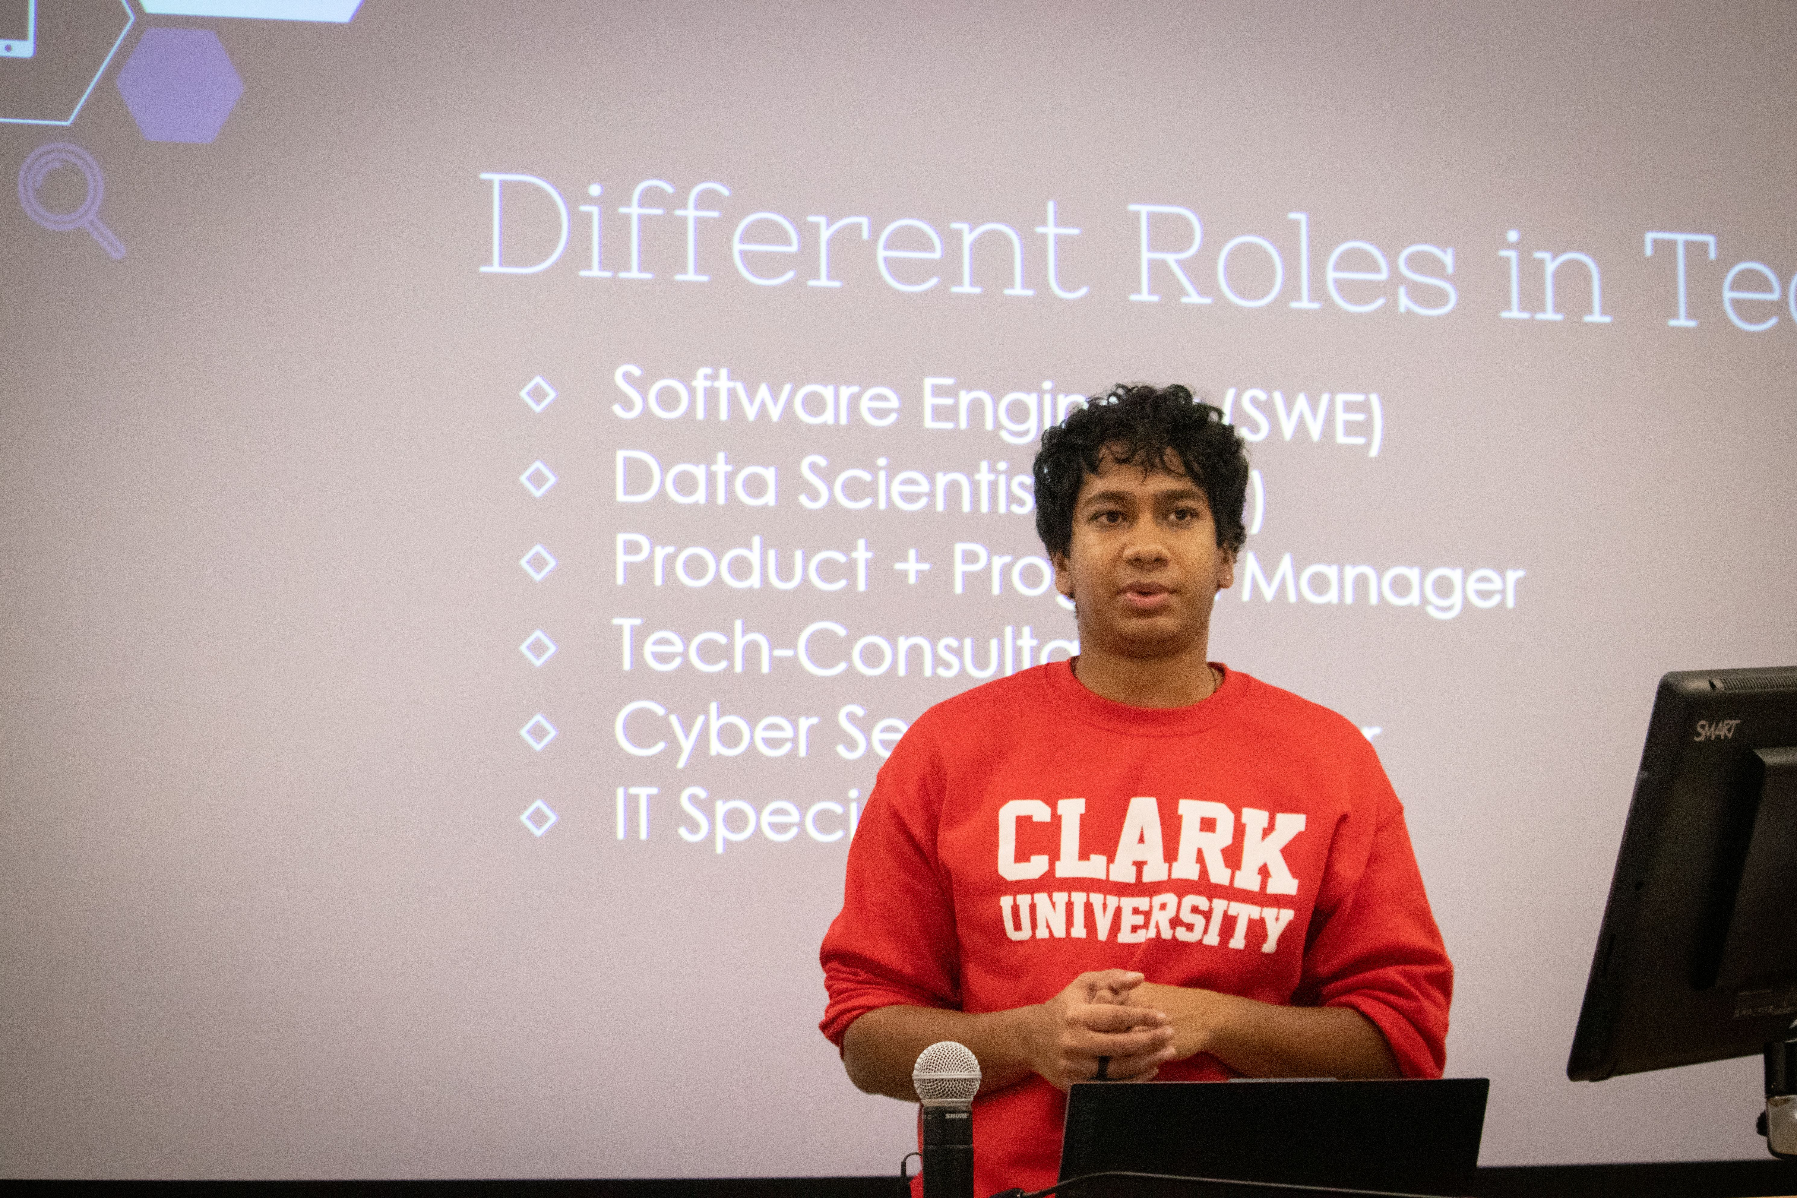
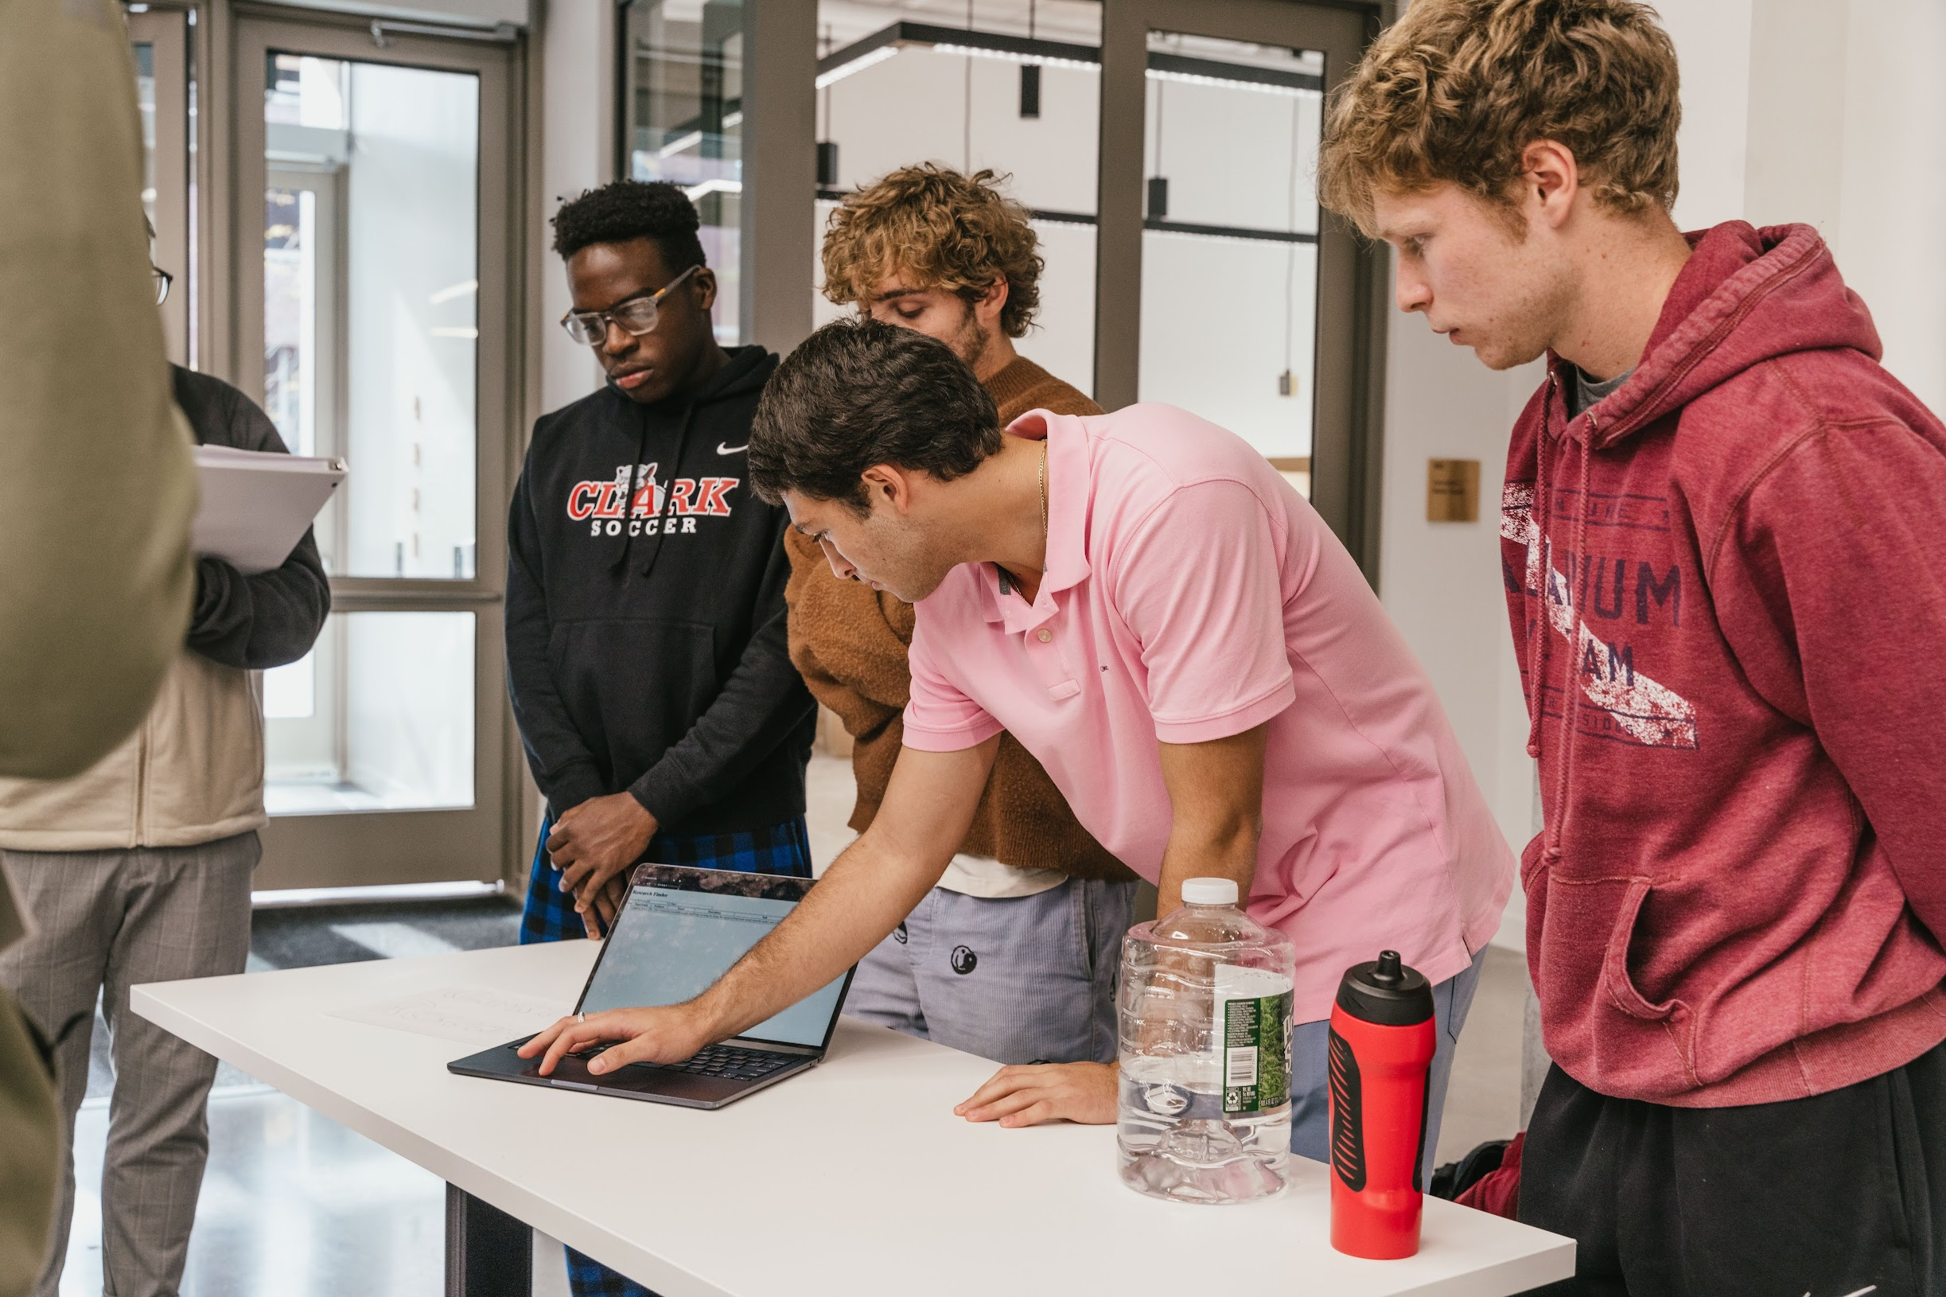
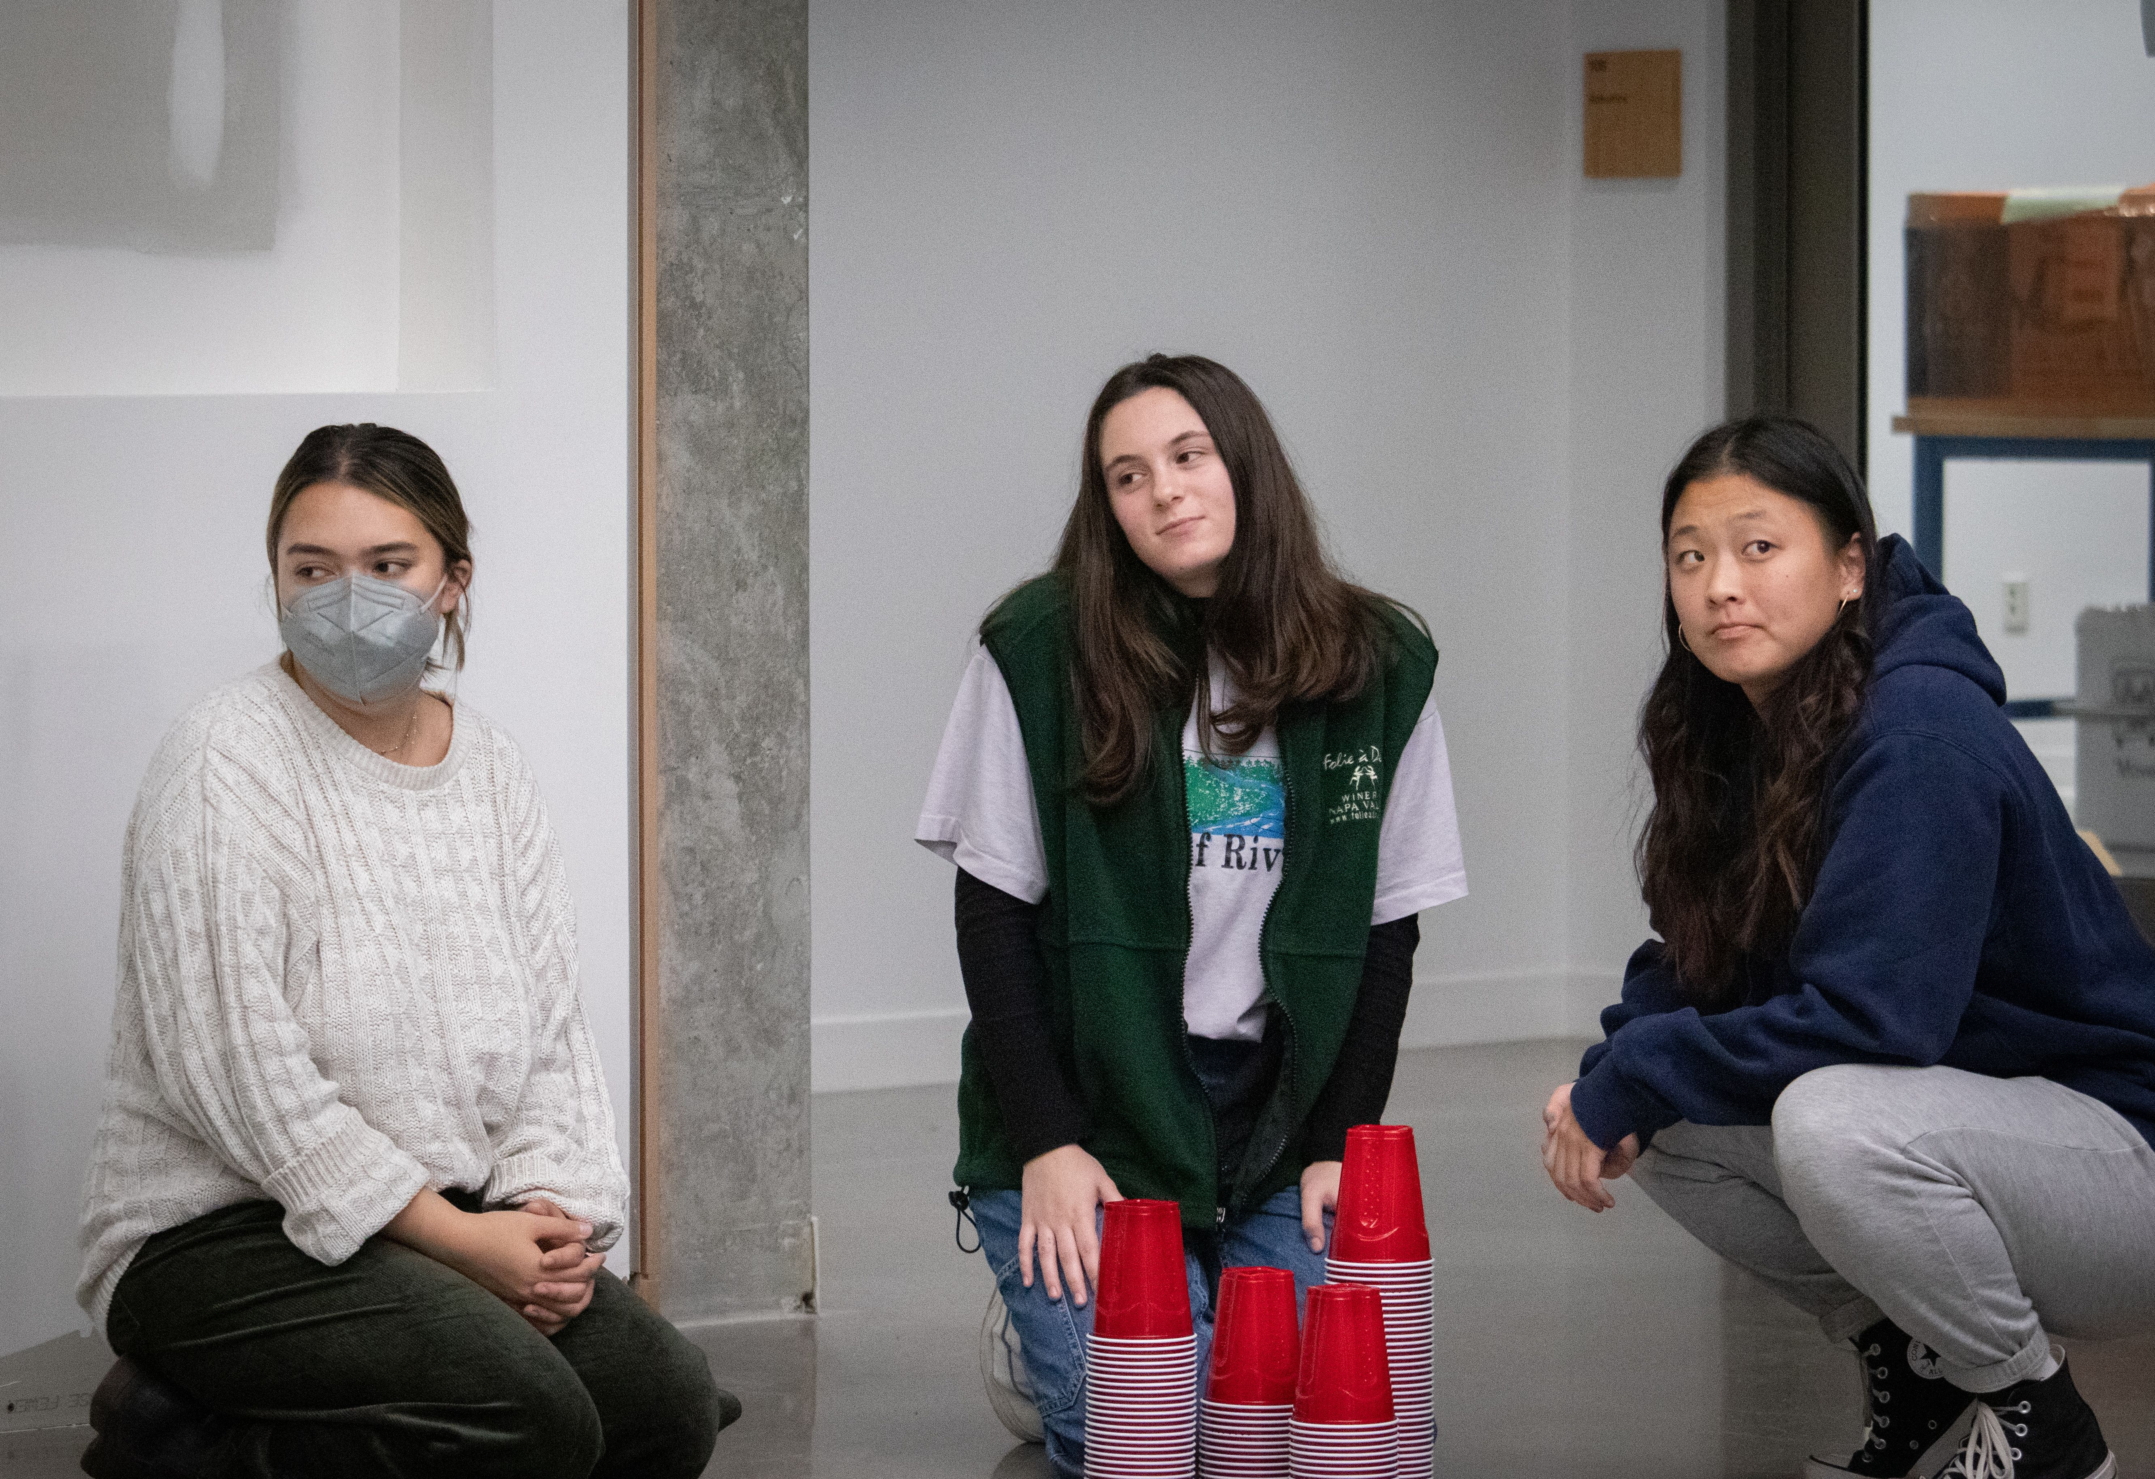
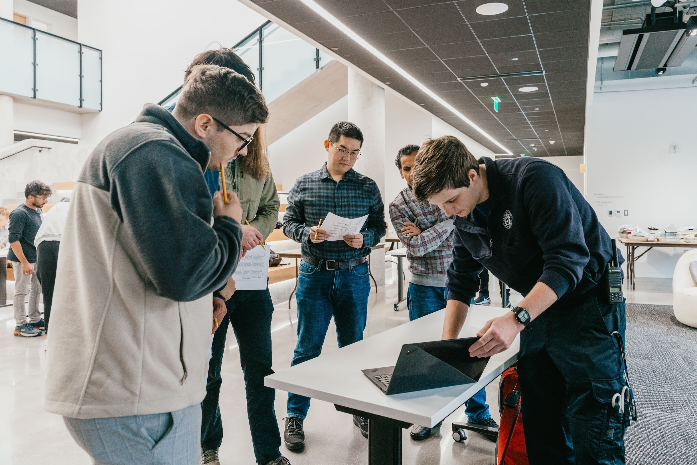
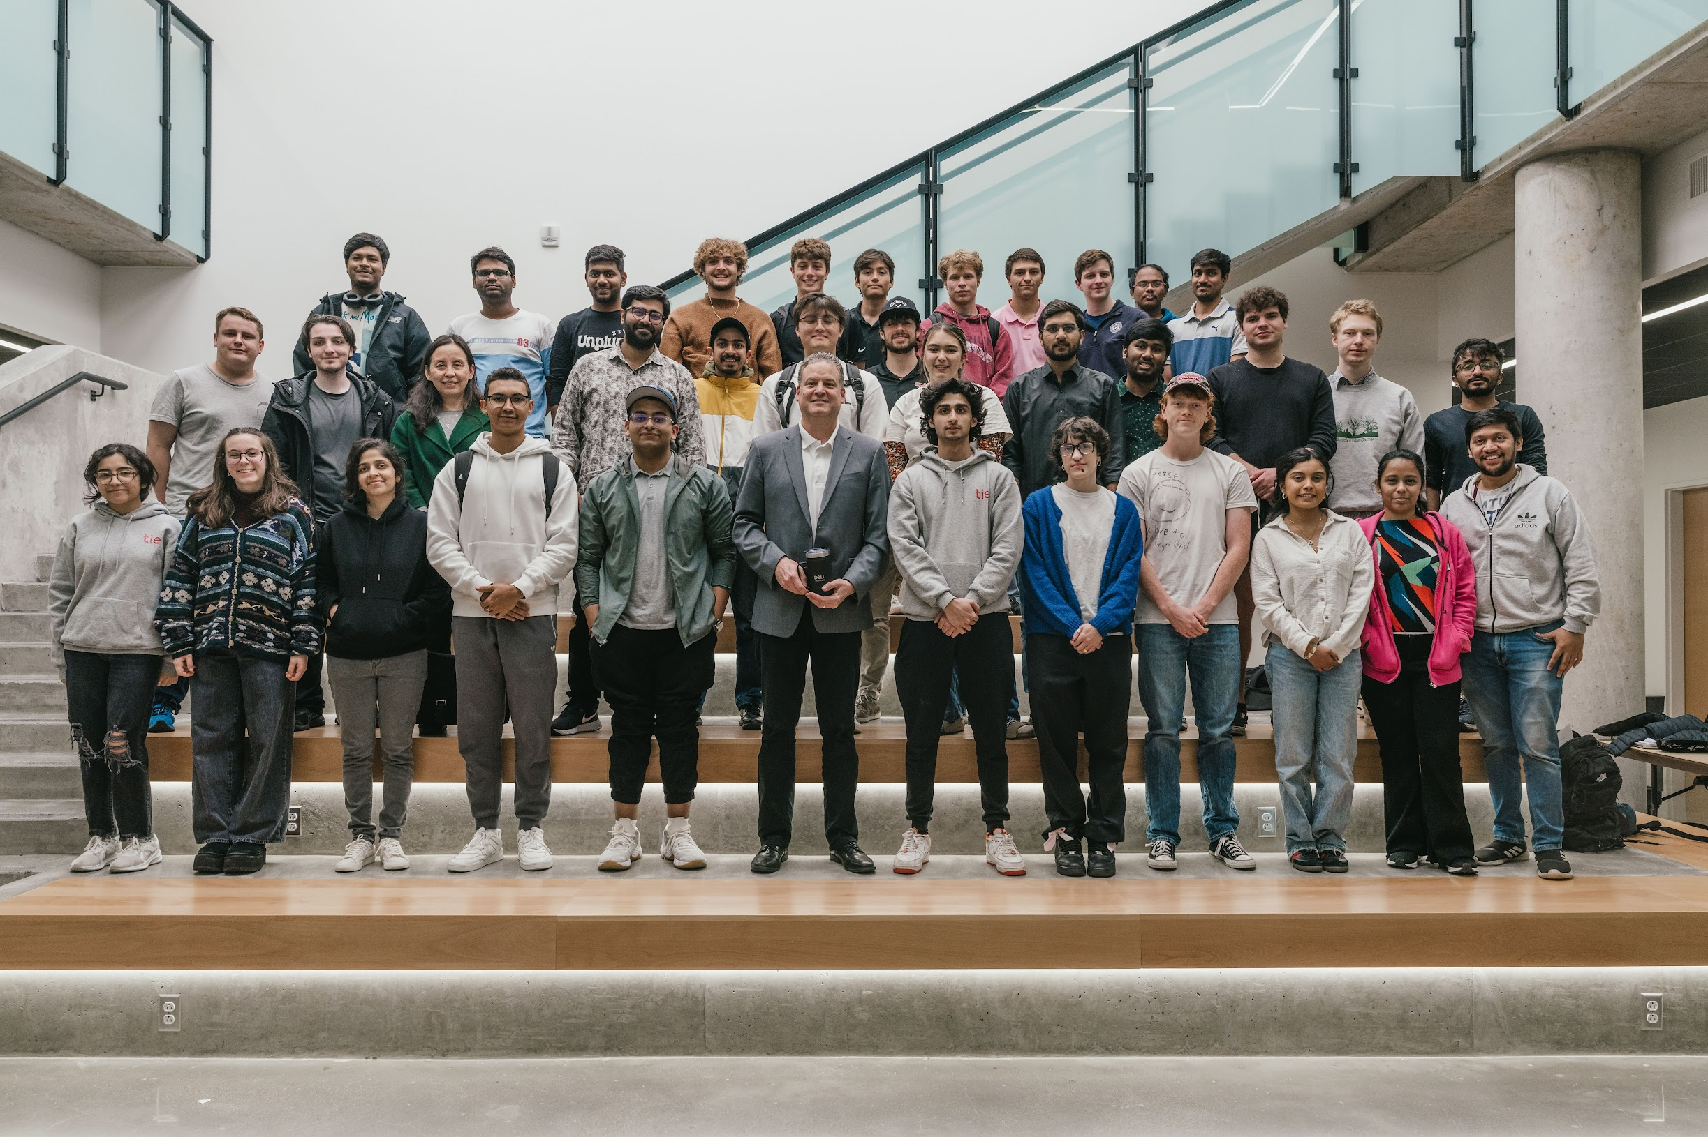
Photos by Natalie and Danny

Slide 2
Clark Competitive Computing Club (C4) – Spring 2024 Hackathon Grant Proposal
Budget Outline
What is the C4 Hackathon?
The Clark Competitive Computing Club (C4) Spring 2024 Hackathon is a unique opportunity to promote innovation and collaboration among technology-focused undergraduate students at Clark University. This Hackathon is open to all undergraduate students enrolled within the university, and we encourage students of all backgrounds and interests to participate in this exciting event.
Item | Cost
1st place prizes | $500
2nd place prizes | $300
3rd place prizes | $200
Snacks & drinks (3 days) | $500
Brunch (2), dinner (2) | $2000
GRAND TOTAL | $3500
Proposed Dates, Location(s), Time(s):
Dates: Friday, February 23rd – Sunday, February 25th
Times: Opening ceremony will begin Friday evening. Hacking will commence from the conclusion of the opening ceremony until Sunday afternoon. Judging will commence Sunday afternoon and then the closing ceremony as well as winner’s announcement will take place Sunday evening.
Location: CMACD building, open workspace throughout the building, with certain rooms reserved for specific lectures and events.
Hackathon Theme Proposal
The overarching theme of the Hackathon will be sustainability and the environment. Participants will be challenged to explore and address issues related to environmental conservation, climate change, waste reduction, renewable energy, and other critical sustainability topics. By focusing on these challenges, the hackathon seeks to inspire and encourage solutions that can make a tangible impact on the planet.
How Clark can Benefit from this Hackathon
Hosting this hackathon holds the potential for significant and long-lasting benefits. Beyond the immediate positive impact on the student body, faculty, and the institution’s reputation, the hackathon offers a unique opportunity for the school to harness the innovative solutions generated by participants. Successful student projects have the potential to be integrated into the school’s existing technological infrastructure, enhancing operational efficiency, and creating sustainable improvements.
Purpose/Objectives:
Skill development
Innovation and creativity
Collaboration
Networking opportunities
Practical application of knowledge
Connect with industry through portfolio creation

